Slide 1
IoT Based Landslide Detection and Monitoring System
Second Review
Batch Number: 06
Sri Sowharan P K 20TUCS229
Ukesh R 20TUCS246
Vasanth M 20TUCS248
Guided By
Mr. T. Raghunathan

Slide 2
Outline
Base Paper
Abstract
Introduction
Literature Survey
Problem Definition
Objective
Methodology

Slide 3
Base Paper
Title of the Paper | LoRa Based Metrics Evaluation for Real-Time Landslide Monitoring on IoT Platform
Author | Swapnil Bagwari, Ajay Roy1, Anita Gehlot, Rajesh Singh , Neeraj Priyadarshi and Baseem Khan
Year | 2022
Journal | IEEE

Slide 4
Abstract
In the proposed system ,we have developed a IoT based landslide detection system that utilize different type of sensors to gather data from the field, to identify places that may be prone to landslides based on gathered data and current environmental conditions. In the existing system, the data are inaccurate so it causes the threats to the human life and property devastation. They also can’t analyze the surface and can’t gather efficient data due to the absence of Ground Penetrating Radar. The proposed system is effective and economical. It stores data in the cloud, to analyzes data at the surface level, and collects data using ground penetrating radar, uses Wi-Fi module to facilitate quick data transfer.

Slide 5
Introduction
In the suggested system, we have created an Internet of Things (IoT) based landslide detection system that uses several types of sensors to collect field data and identify locations that might be vulnerable to landslides based on the data collected and the current environmental conditions.
The data in the current system are erroneous, endangering human life and causing destruction to property.
Additionally, because Ground Penetrating Radar is not available, they are unable to study the surface or collect effective data.
The suggested system is both inexpensive and efficient.
It employs a Wi-Fi module to enable speedy data transfer, stores data in the cloud, analyzes data at the surface, and gathers data using ground penetrating radar.

Slide 6
Literature Survey
Title | Author | Journal & Year
Efficient IoT-enabled Landslide Monitoring | Matthew Butler, Dr. Marios Angelopoulos, Doug Mahy | IEEE, 2020
Unmanned Aerial Vehicle Surveying and Mapping Trajectory Scheduling and Autonomous Control for Landslide Monitoring | Shifang Liao, Manzhu Ye, Rongcai Yuan, and Wanzhi Ma | Hindawi Journal of Robotics Volume 2022,
IOT Based Landslide Detection | Sanjay Kewat, Abhijeet Mane, Prem Mevada, Prof. Satish Kuchiwale | International Research Journal of Engineering and Technology, 2022

Slide 7
Problem Definition
There are numerous issues with the current system include poor data quality and accuracy, restricted ground penetrating radar availability, a lack of real-time monitoring, expensive installation costs, and difficulty integrating data from multiple sources.
We proposed that by adding various sensors and GPR we can get accurate data for lower cost.

Slide 8
Methodology
In this paper we proposed a system to detect the possibilities of a landslide by tracking the environment using
Soil Sensor
Humidity Sensor
Vibration Sensor
GSM Sensor
Rainfall Sensor

Slide 9
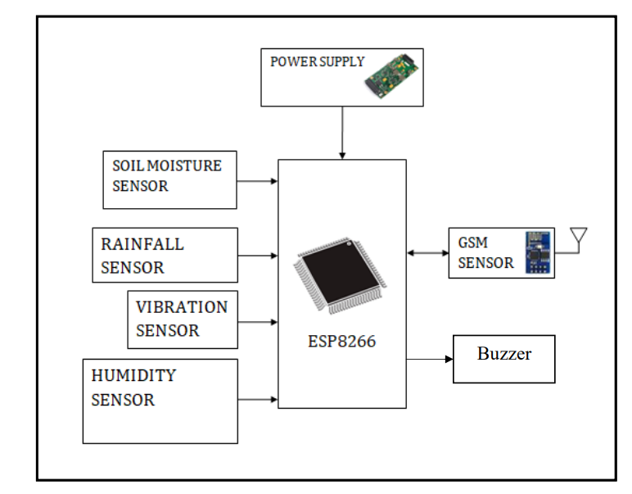
Block Diagram

Slide 10
PROPOSED SYSTEM
In this proposed system for landslide detection,we are using multiple sensors to gather various field data for multiple analysis and to reduce the impacts of the landslide.
Arduino board is used in the development of the system along with the vibration sensors, soil moisture sensors and WiFi module.
The system we are using have a WiFi module to quick data transfer.
WiFi enables the sensors and board connect to the Internet Service Provider (ISP).
All the sensors collect the real time data and with the help of Arduino development board the data is send to the cloud storage ThingSpeak.
ThingSpeak by Mathworks uses MATLAB as a powerful tool to analyze the data and present .
It in the form of graph that can be easily readable.

Slide 11
MODULAR DESCRIPTION
Sensing Module
Data Processing and Analysis
Monitoring and Surveillance
Web Application
Message Alert System
Buzzer Alert System

Slide 12
DETAILED DESCRIPTION
Sensing Module:
Gather data from various sensors like inclinometers, accelerometers, rainfall gauges, and seismometers deployed in landslide-prone areas and the data are used to solve the impact on the field.
Data Processing and Analysis:
Process data from sensors and remote sources to identify precursors and patterns indicative of landslide risks. Integrates spatial data to create risk maps and assess the potential impact areas.

Slide 13
Monitoring and Surveillance
Ensures real-time surveillance using a network of sensors and remote monitoring systems. Predicts potential landslide occurrences based on ongoing environmental changes and historical data.
Web Application
in this system we are using web application for monitoring and surveillance and to use the gathered data efficiently.

Slide 14
Message Alert System
A message alert system is designed to send notifications to individuals to inform them of various situations, or updates. These systems can be implemented in various contexts, such as emergency notifications.
Buzzer Alert System
A buzzer alert system is a mechanism designed to emit an audible alarm or buzzing sound to signal an event, warning, or reminder. These systems are used as alaram notification to intimate the peoples around the location.

Slide 15
DETAILS ABOUT THE PLATFORM,DATASET AND TOOLS
PLATFORMS
Arduino Development Board
ESP8266 Wi-Fi
Ground-Based Platforms
DATASETS
Flatfile.ino
TOOLS
Geographic Information Systems (GIS)
Matlab-Thingspeak
Data Analysis Tools

Slide 16
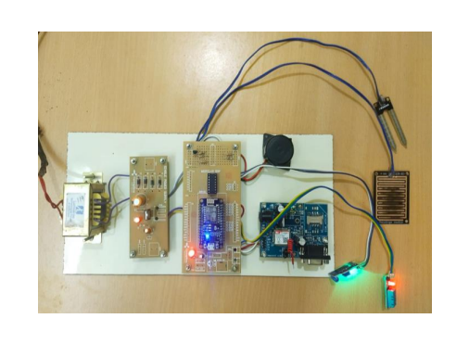
OUTPUTS AND SCREENSHOTS

Slide 17
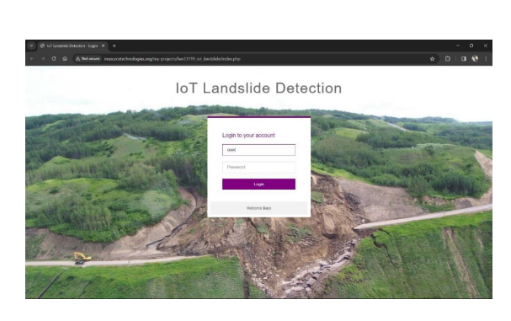
Webpage

Slide 18
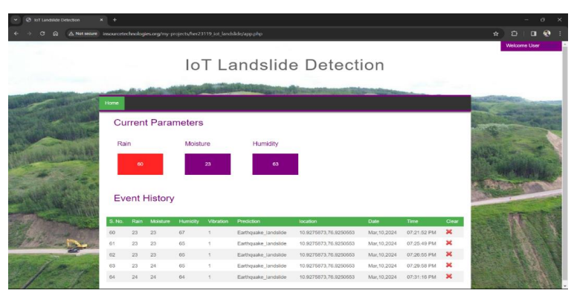
Webpage

Slide 19
CONCLUSION
The proposed system will not only help us to detect landslide but also to send a message at the concerned authority where other emergency message also can be sent.
With the help of sensors can be sent which will eventually save lives and prevent damage to the cars, properties etc. Also after the data is received from hardware to the website using wifi module the authority can act accordingly.
Here,we declare that the suggested system will be cost efficient and highly accurate data will be shared.

Slide 20
REFERENCE
Jadhav Kanchan Eknath, Nalegaonkar Abhilash Dashrath, Salunke Vaishnavi Pandurang, Rajole Savita Dinkar "IOT Based Landslide Detection & Prevention System," IJARIIE-ISSN(O)-2395-4396, Vol4 Issue-2 2018
Pawar Pitambar, Patil Akshay, Rathod Hardik, "IOT Based Landslide Detection & Monitoring," IIJARA(E_ISSN 2348-1269, P- ISSN 2349-2138), May 2019 Volume 6, Issue 2
M. R. Surthy, R. Anjana, V. Dhanya "IOT Based Landslide Detection and Monitoring System," IJRESM ISSN: 2581- 5792 Volume-3, Issue-4, April2020
D. Petley, R. Rakuts, Global patterns of loss of life from landslide, Geologym Vol.40, no.10, p.921,2014.
Putri Fatimah, Budhi Irawan, Casi Setiannigshi, "Design og Landslide Early Warning System Using Fuzzy Method Based on Android." 2020 12th Internation al Conference on Information Technology and Electrical Engineering (ICITEE), Yogyakarta, Indonesia.

